Slide 1
Lecture:8 Introducing Operator Overloading
Prepared By: Sumaiya Binte Shahid
Lecturer
Department of CSE, BUBT

Slide 2
The Basics Of Operator Overloading
In C++, Operator overloading is a compile-time polymorphism. It is an idea of giving special meaning to an existing operator in C++ without changing its original meaning.
For example, we can overload an operator ‘+’ in a class like String so that we can concatenate two strings by just using +. Other example classes where arithmetic operators may be overloaded are Complex Numbers, Fractional Numbers, Big integers, etc.
Operator functions are the same as normal functions. The only differences are, that the name of an operator function is always the operator keyword followed by the symbol of the operator, and operator functions are called when the corresponding operator is used.

Slide 3
The Basics Of Operator Overloading
Here, variables “a” and “b” are of types “int” and “float”, which are built-in data types. Hence the addition operator ‘+’ can easily add the contents of “a” and “b”. This is because the addition operator “+” is predefined to add variables of built-in data type only.
int a;
float b,sum;
sum = a + b;
class A
{ statements;
};
int main()
{
A a1, a2, a3;
a3 = a1 + a2;
return 0;
}
In this example, we have 3 variables “a1”, “a2” and “a3” of type “class A”. Here we are trying to add two objects “a1” and “a2”, which are of user-defined type i.e. of type “class A” using the “+” operator. This is not allowed, because the addition operator “+” is predefined to operate only on built-in data types. But here, “class A” is a user-defined type, so the compiler generates an error. This is where the concept of “Operator overloading” comes in.

Slide 4
The Basics Of Operator Overloading
Can We Overload All Operators?
Almost all operators can be overloaded except a few. Following is the list of operators that cannot be overloaded.
sizeof
typeid
Scope resolution (::)
Class member access operators (.(dot), .* (pointer to member operator))
Ternary or conditional (?:)
Operators that can be Overloaded in C++
We can overload
Unary operators
Binary operators
Special operators ( [ ], (), etc)

Slide 5
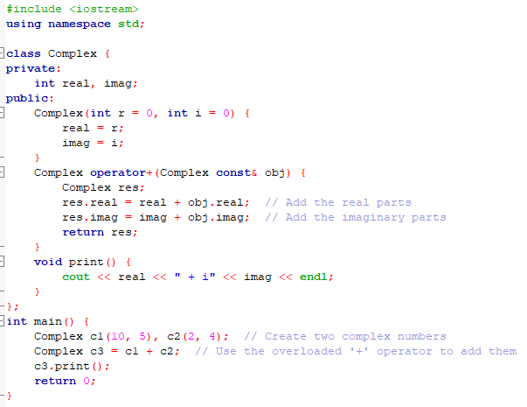
Operator Overloading

Slide 6
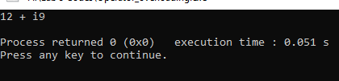
Operator Overloading
The main idea behind “Operator overloading” is to use C++ operators with class variables or class objects. Redefining the meaning of operators really does not change their original meaning; instead, they have been given additional meaning along with their existing ones.

Slide 7
Overloading Binary Operator
In the binary operator overloading function, there should be one argument to be passed. It is the overloading of an operator operating on two operands.
The object on the left side is the object that generates the call to the operator function and is passed implicitly by this.
It is important to understand that operator functions can be written with many variations.
*** See Example 2, Page 151

Slide 8
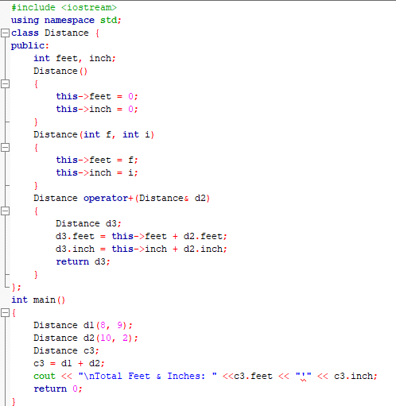
Overloading
Binary
Operator

Slide 9
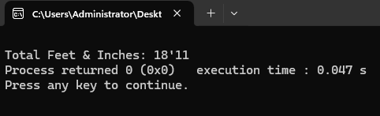
Output
Explanation: Distance operator+(Distance &d2): Here return type of function is distance and it uses call by references to pass an argument.
d3 = d1 + d2: Here, d1 calls the operator function of its class object and takes d2 as a parameter, by which the operator function returns the object and the result will reflect in the d3 object.

Slide 10
Overloading The Relational And Logical Operators
When you overload the relational and logical operators so that they behave in their traditional manner, you will not want the operator functions to return an object of the class for which they are defined. Instead, they will return an integer that indicates either true or false.
This not only allows these operator functions to return a true/false value, it also allows the operators to be integrated into larger relational and logical expressions that involve other types of data.

Slide 11
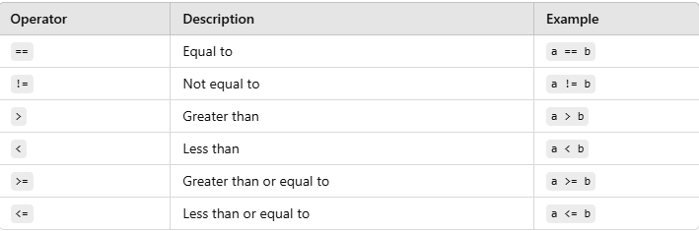
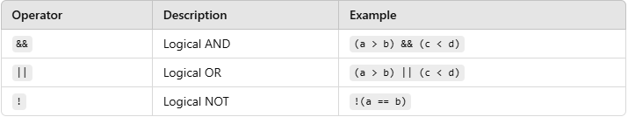
Relational And Logical Operators

Slide 12
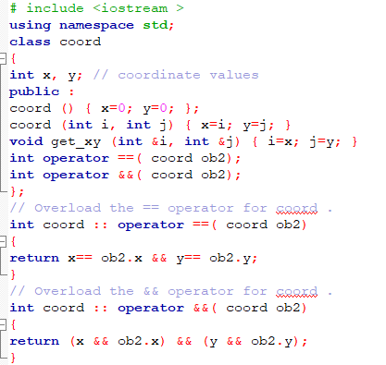
The Relational And Logical Operators

Slide 13
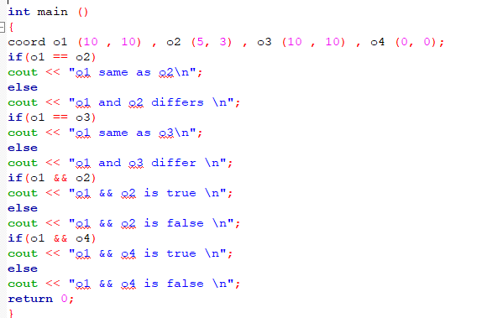
The Relational And Logical Operators

Slide 14
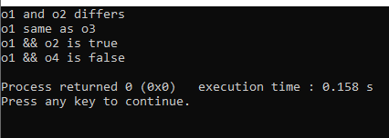
Overloading The Relational And Logical Operators
In the above program, the == and && operators are overloaded.

Slide 15
Overloading a Unary Operator
Overloading a unary operator is similar to overloading a binary operator except that there is only one operand to deal with.
When you overload a unary operator using a member function, the function has no parameters.
Since there is only one operand, it is this operand that generates the call to the operator function.
There is no need for another parameter.

Slide 16
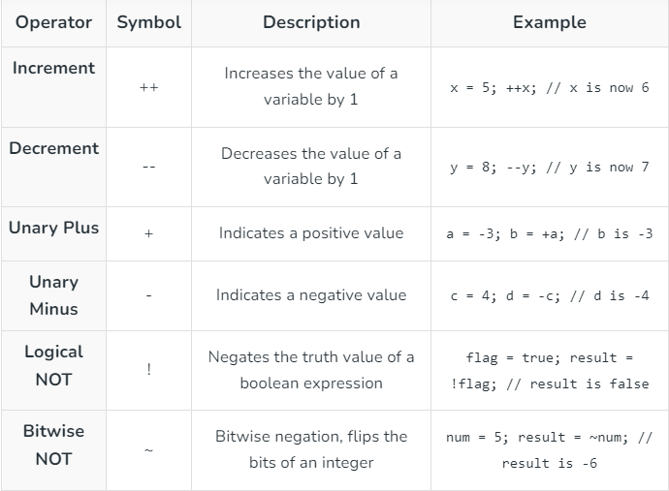
Unary Operators

Slide 17
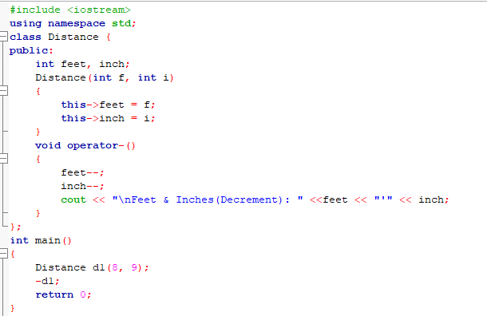

Overloading a Unary Operator

Slide 18
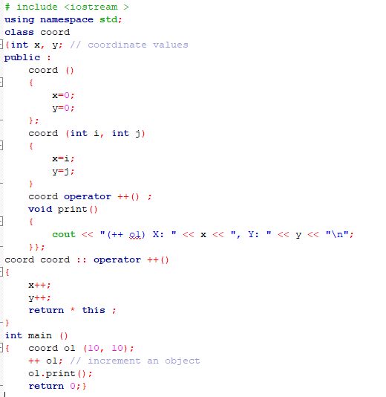
Overloading a Unary Operator

Slide 19

Overloading a Unary Operator
Explanation: Since the increment operator is designed to increase its operand by 1, the overloaded ++ modifies the object it operates upon. The function also returns the object that it increments. This allows the increment operator to be used as part of a larger statement, such as this: o2 = ++ o1;
As with the binary operators, there is no rule that says you must overload a unary operator so that it reflects its normal meaning. However, most of the time this is what you will want to do.
*** See Example 3, Page:158

Slide 20
*** See Example 3, Page:158
As you know, the minus sign is both a binary and a unary operator in C++. You might be wondering how you can overload it so that it retains both of these uses relative to a class that you create. The solution is actually quite easy: you simply overload it twice, once as a binary operator and once as a unary operator. This program shows how:

Slide 21
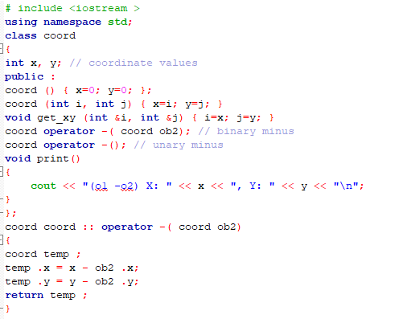
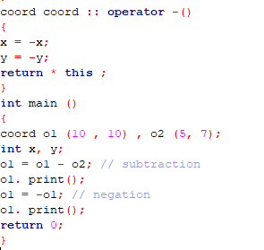

Slide 22
Using Friend Operator Functions
Purpose of Friend Functions:
Friend functions allow operators to be overloaded relative to a class without requiring them to be class members.
Unlike member functions, friend functions don’t have access to the this pointer.
This allows both operands to be passed explicitly in binary operators, while unary operators have a single operand passed directly.

Slide 23
Using Friend Operator Functions
Why Use a Friend Over Member Functions?:
Generally, using a friend function over a member function for operator overloading is optional. The main exception occurs when external access to class members is necessary, demonstrated here with the binary + operator.
A notable restriction is that the assignment operator = can only be overloaded with a member function, not a friend function.

Slide 24
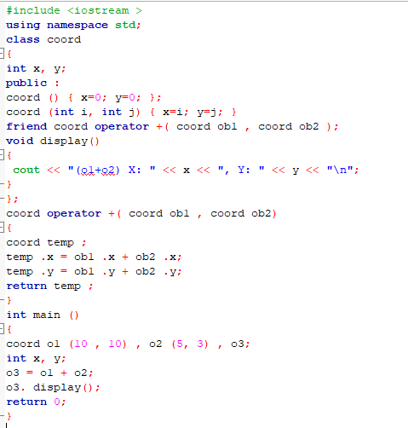
Using Friend Operator Functions

Slide 25
Using Friend Operator Functions
Friend functions allow more flexible overloading of operators compared to member functions. Specifically, they let objects interact with built-in types even when the built-in type is on the left side of the operator, something member functions cannot do.
Member functions can overload operators when the left operand is an object and the right is a built-in type, like object + 10 (legal).
However, the reverse, 10 + object, is not possible with member functions.
To handle both cases (object + int and int + object), two friend operator functions are defined:
One where the object is on the left side (object + int).
Another where the built-in type is on the left side (int + object).

Slide 26
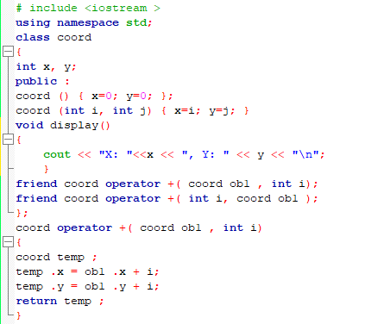
Using Friend Operator Functions

Slide 27
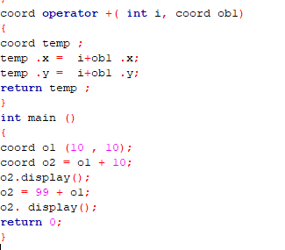
Using Friend Operator Functions

Slide 28
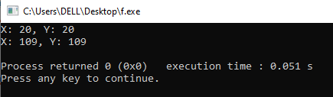
Using Friend Operator Functions
By defining two friend functions, operator+(coord, int) and operator+(int, coord), you handle both cases explicitly. This lets you use the object on either side of the operator, something member functions can’t achieve because they’re always bound to the object on the left.
Explanation:

Slide 29
Using Friend Operator Functions
If you are using a modern compiler, you can also distinguish between the prefix and the postfix forms of the increment or decrement operators when using a friend operator function in much the same way you did when using member functions. You simply add an integer parameter when defining the postfix version. For example, here are the prototypes for both the prefix and postfix versions of the increment operator relative to the coord class:
coord operator ++( coord &ob); // prefix
coord operator ++( coord &ob , int notused ); // postfix
If the ++ precedes its operand, the operator++(coord &ob) function is called. However, if the ++ follows its operand, the operator++(coord &ob, int notused) function is used. In this case, notused will be passed the value 0.

Slide 30
Assignment Operator Overloading
The assignment operator,”=”, is the operator used for Assignment. It copies the right value into the left value. Assignment Operators are predefined to operate only on built-in Data types.
Assignment operator overloading is binary operator overloading.
Overloading assignment operator in C++ copies all values of one object to another object.
Only a non-static member function should be used to overload the assignment operator.

Slide 31
Assignment Operator Overloading
In C++, the compiler automatically provides a default assignment operator for classes. This operator performs a shallow copy of each member of the class from one object to another. This means that if we don’t explicitly overload the assignment operator, the compiler will still allow us to assign one object to another using the assignment operator (=), and it won’t generate an error.
So, when we should perform assignment operator overloading? when our class involves dynamic memory allocation (e.g., pointers) and we need to perform a deep copy to prevent issues like double deletion or data corruption.

Slide 32
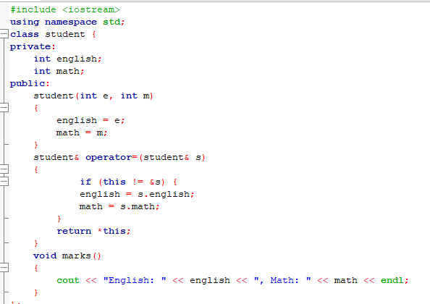
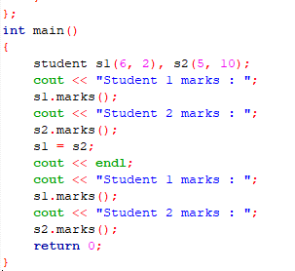
Assignment Operator Overloading

Slide 33
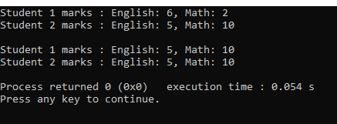
Assignment Operator Overloading
When you assign s1 = s2, this function ensures that all values from s2 (both english and math) are copied to s1. if (this != &s) checks if the current object (this) is not the same as s. This avoids self-assignment (e.g., s1 = s1).
It then copies the english and math marks from s2 to s1.
Explanation:

Slide 34
Overloading The [ ] Subscript Operator
The last operator that we will overload is the [ ] array subscripting operator. In C++, the [ ] is considered a binary operator for the purposes of overloading. In C++, the subscript operator is commonly used to access elements of an array. The [ ] can be overloaded only by a member function. Therefore, the general form of a member operator[ ]() function is as shown here:
type class_name :: operator []( int index )
{
// ...
}
Technically, the parameter does not have to be of type int, but operator[ ]() functions are typically used to provide array subscripting and as such an integer value is generally used.

Slide 35
Overloading The [ ] Subscript Operator
To understand how the [ ] operator works, assume that an object called O is indexed as shown here:
O [9];
This index will translate into the following call to the operator[ ]() function:
O. operator [](9)
That is, the value of the expression within the subscripting operator is passed to the operator []() function in its explicit parameter. The this pointer will point to O, the object that generated the call.

Slide 36
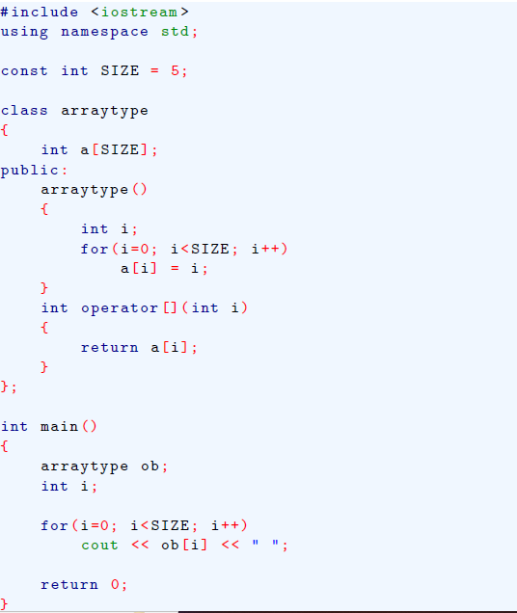
Overloading The
[ ] Subscript Operator

Slide 37
Overloading The [ ] Subscript Operator
In the following program, arraytype declares an array of five integers. Its constructor function initializes each member of the array. The overloaded operator[ ]() function returns the value of the element specified by its parameter. This program displays the following output:
0 1 2 3 4
The initialization of the array a by the constructor
***See example 2 on page 167

Slide 38

Thank You

